Slide 1
The spreading of incineration emissions into the surroundings
Kees Olie
University of Amsterdam

Slide 2
Overview
What happens with the particles in the flue gas from the stack?
What happens with the particles when they reach the ground
Open burning

Slide 3
What is the expected deposition from an incinerator?
This can be calculated knowing wind direction, wind speed , stack height, flue gas temperature and assuming a certain mean particle size.
K. Olie, M. van den Berg, and O. Hutzinger. Formation and fate of PCDD and PCDF from combustion processes. Chemosphere 12(4/5):627-636, 1983.

Slide 4
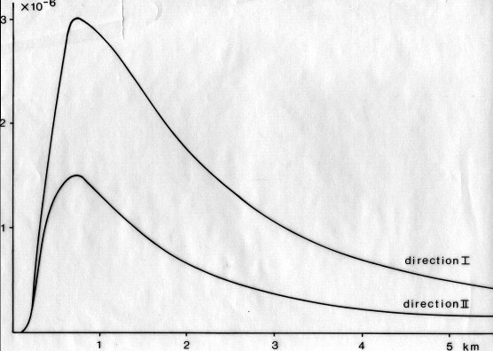
Distribution from the stack in 2 directions

Slide 5
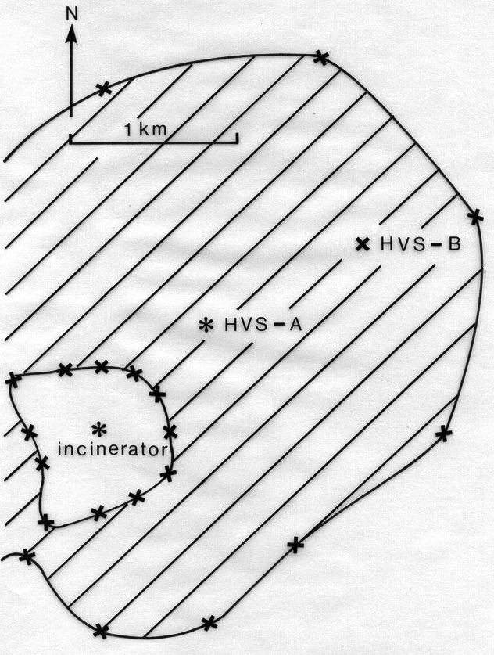
Prediction of areas with high levels of PCDD/F’s in grass

Slide 6
Cows milk
In 1989 it was found that cows milk near an incinerator did contain too high levels of PCDD/F’s
The milk was taken out of the market for many years.
The incinerator is upgraded in the meantime
Other incinerators were closed down

Slide 7
Open burning
What is needed for the formation of PCDD/F’s?
Carbon
Oxygen
Catalyst
Chlorine
Temp between 200 and 350 ^{O} C
All is there and no cleaning of the offgas

